Slide 1

Note: The data and information in this document is reflective of a hypothetical situation and client. This document is to be used for KPMG Virtual Internship purposes only.
Sprocket Central Pty Ltd
Data analytics approach
Jalil Davudlu / student

Slide 2
Note: The data and information in this document is reflective of a hypothetical situation and client. This document is to be used for KPMG Virtual Internship purposes only.
Agenda
Introduction
Data Exploration
Model Development
Interpretation

Slide 3
Note: The data and information in this document is reflective of a hypothetical situation and client. This document is to be used for KPMG Virtual Internship purposes only.
Introduction
Customers’ age distribution
Customers’ gender distribution
Customers’ wealth segment
Car owner customers
Sum of purchases in the last 3 years for each gender
Job Industry Category
Total number of customers from each state

Slide 4
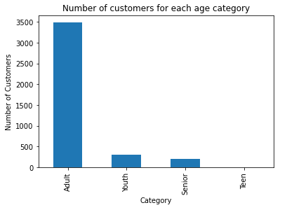
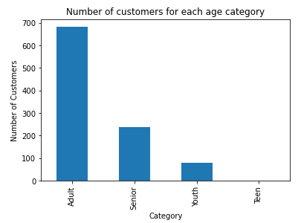
Note: The data and information in this document is reflective of a hypothetical situation and client. This document is to be used for KPMG Virtual Internship purposes only.
Data Exploration
Customers’ age distribution
Top picture demonstrates old customers, bottom is about new ones. Previously, majority of customers who are purchased are adults. When we analyze most of new customers are adults too.

Slide 5
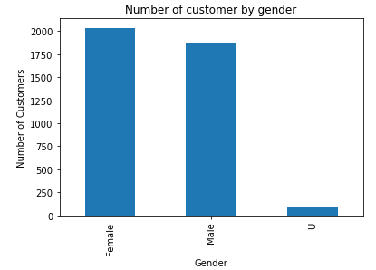
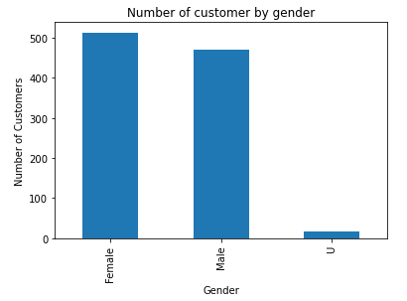
Data Exploration
Customers’ gender distribution
Top picture demonstrates old customers, bottom is about new ones. Previously, majority of customers who are purchased are adults. When we analyze most of new customers are adults too.

Slide 6
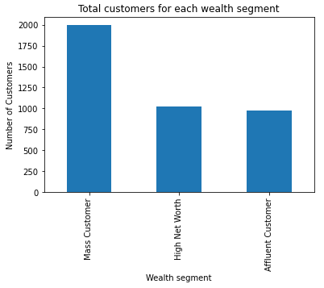
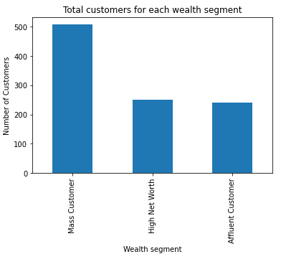
Data Exploration
Customers’ wealth segment
Top picture demonstrates old customers, bottom is about new ones. Previously, majority of customers who are purchased are mass customers. When we analyze most of new customers are mass customers too.

Slide 7
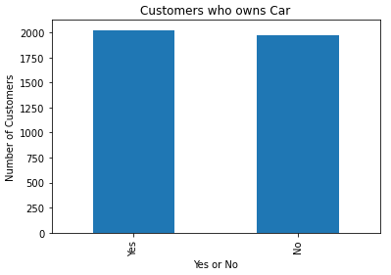
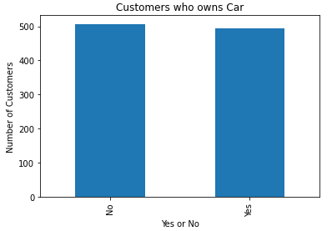
Data Exploration
Car owner customers
Both old and new customers show similar results. Customer who has car has same probability to purchase with who hasn’t.

Slide 8
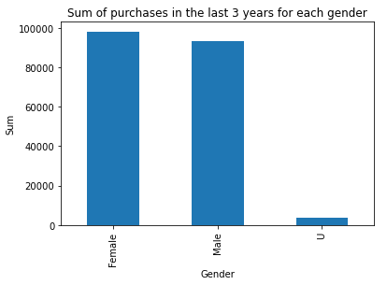
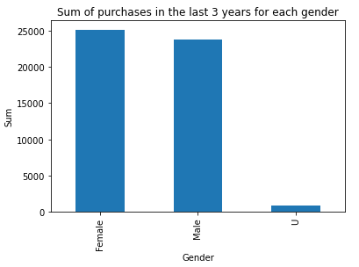
Note: The data and information in this document is reflective of a hypothetical situation and client. This document is to be used for KPMG Virtual Internship purposes only.
Model Development
Sum of purchases in the
last 3 years for each gender
As we see from old customers mostly women purchased for bikes in the last 3 years and women customers in new list are again more than men.

Slide 9
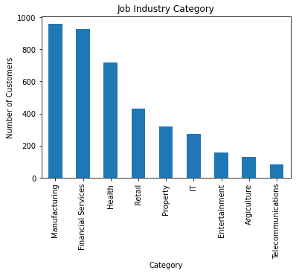
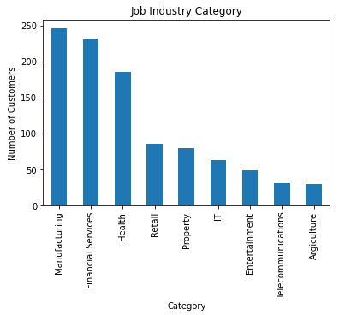
Note: The data and information in this document is reflective of a hypothetical situation and client. This document is to be used for KPMG Virtual Internship purposes only.
Interpretation
Job Industry Category
Previously, top three most purchased companies are manufacturing, financial services, and health. Result of new customers also demonstrates same output.

Slide 10
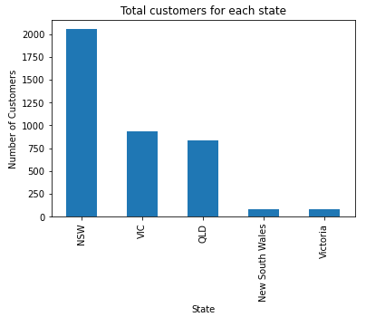
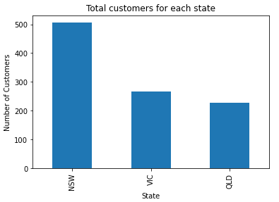
Interpretation
Total number of customers from each state
Our old (top) customers mostly from NSW, VIC, and QLD. As we see from bottom picture our new customers also from same state.

Slide 11
Note: The data and information in this document is reflective of a hypothetical situation and client. This document is to be used for KPMG Virtual Internship purposes only.
Appendix

Slide 12
Note: The data and information in this document is reflective of a hypothetical situation and client. This document is to be used for KPMG Virtual Internship purposes only.
Appendix
This is an optional slide where you may place any supporting items.

